Slide 1
Mason’s Gain Formula

Slide 2
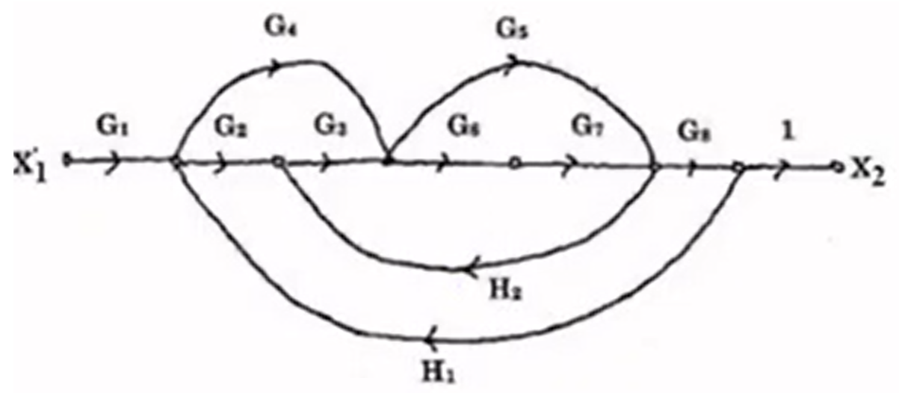
Q: Find the Number of Forward Paths

Slide 3
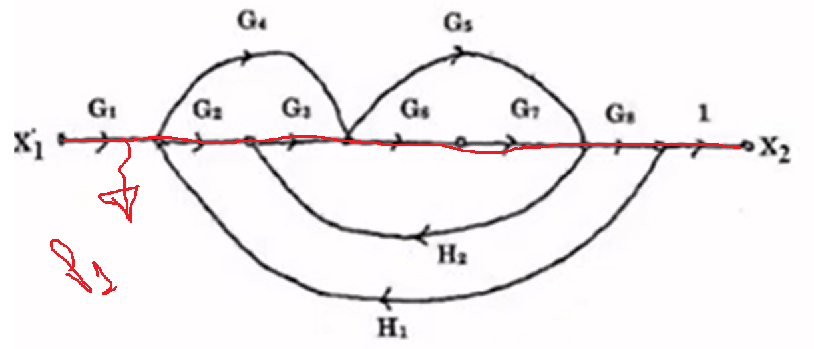
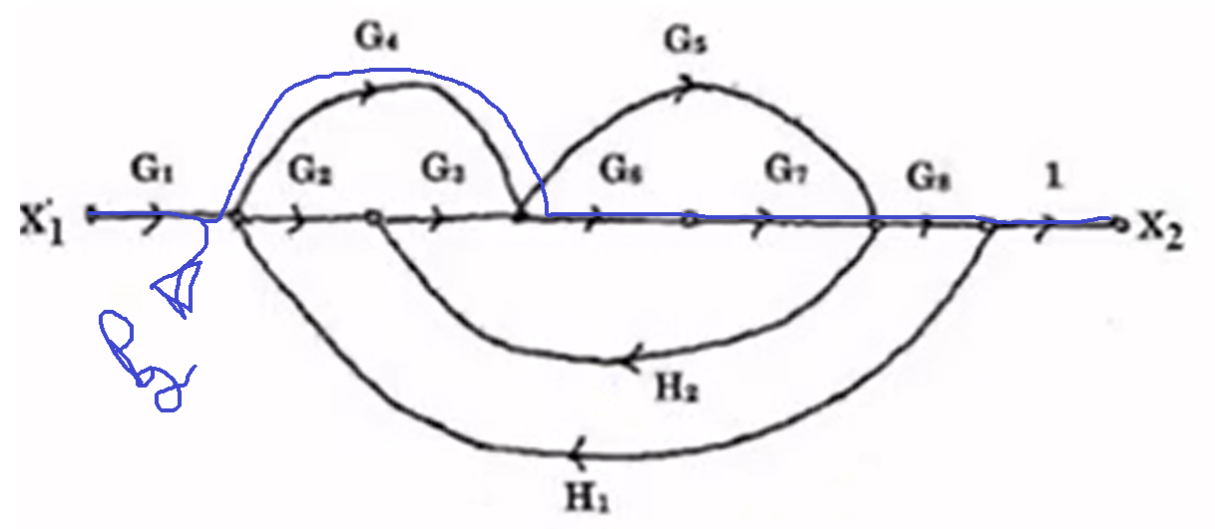
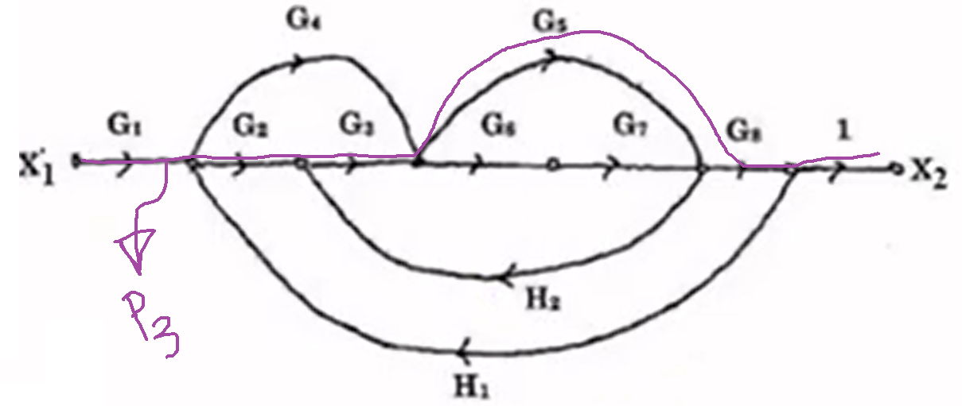
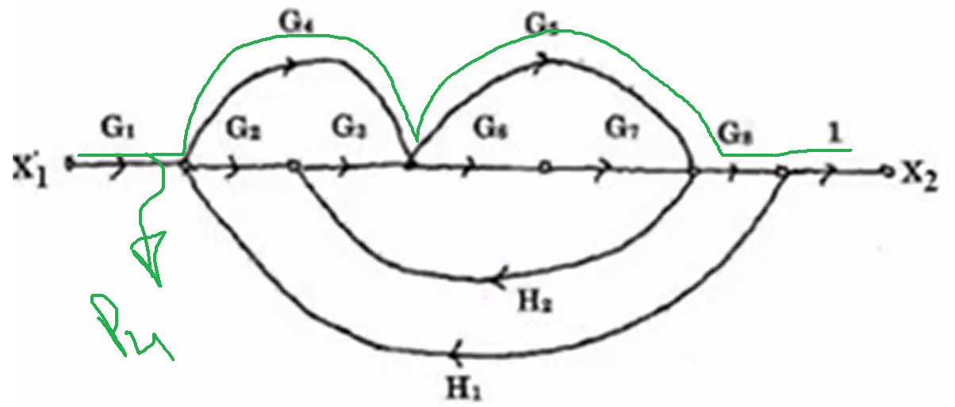
Q: Find the Number of Forward Paths
Number of Forward Paths = K = 4

Slide 4
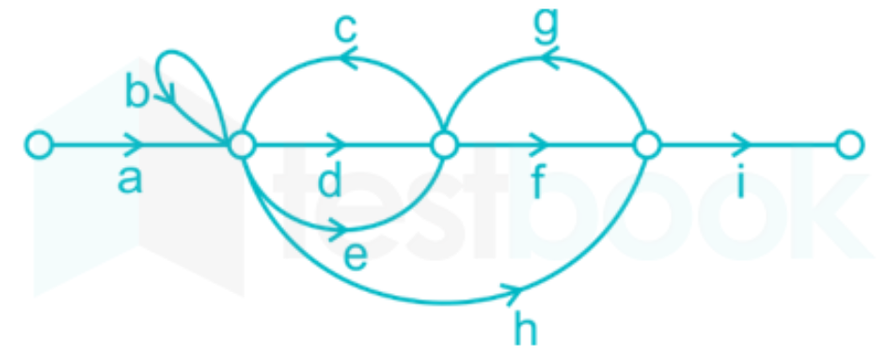
FORWARD PATHS
$${First Forward Path (P}_{1})=adfi$$
$${Second Forward Path (P}_{2})=aefi$$
$${Third Forward Path (P}_{3})=ahi$$
$$Total Forward Path=n=3$$

Slide 5
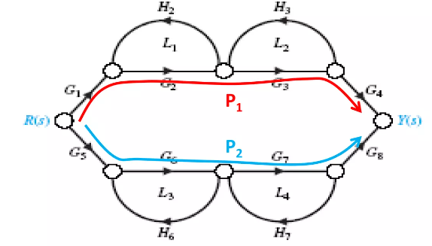
FORWARD PATHS
$${First Forward Path (P}_{1})=G_{1}G_{2}G_{3}G_{4}$$
$${Second Forward Path (P}_{2})=G_{3}G_{6}G_{7}G_{8}$$
$$Total Forward Path=n=2$$

Slide 6
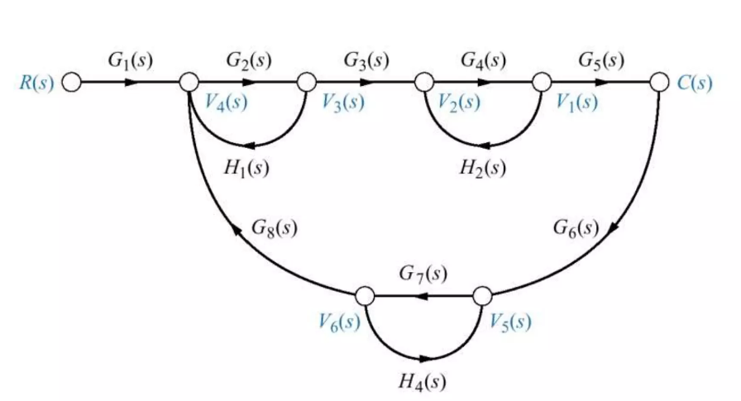
FORWARD PATHS
$${First Forward Path (P}_{1})=G_{1}(s)G_{2}(s)G_{3}(s)G_{4}(s)G_{5}(s)$$
$$Total Forward Path=n=1$$

Slide 7
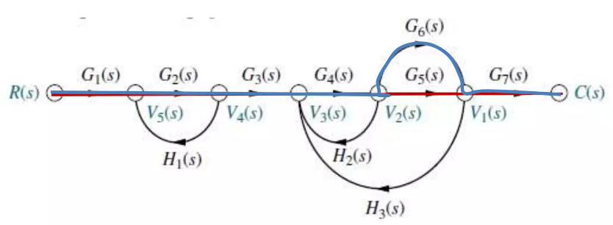
FORWARD PATHS
$$Total Forward Path=n=2$$

Slide 8
FORWARD PATH GAIN
$${First Forward Path Gain (P}_{1})=G_{1}(s)G_{2}(s)G_{3}(s)G_{4}(s)G_{5}(s)G_{7}(s)$$
$${Second Forward Path Gain (P}_{2})=G_{1}(s)G_{2}(s)G_{3}(s)G_{4}(s)G_{6}(s)G_{7}(s)$$

Slide 9
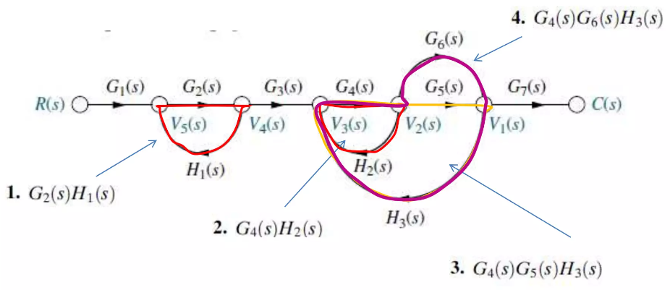
LOOPS
$$Number of Loops=L=4$$

Slide 10
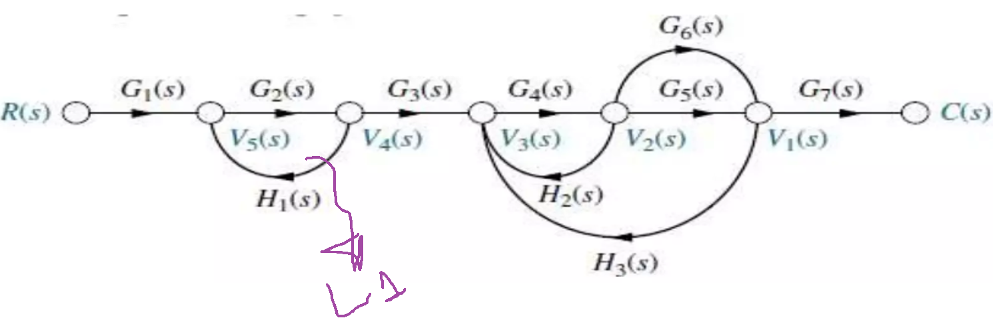
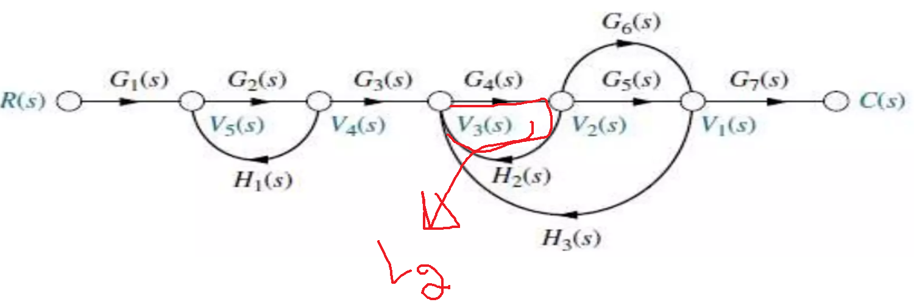
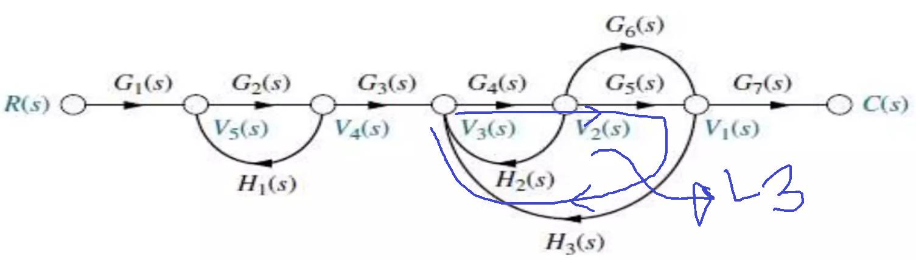
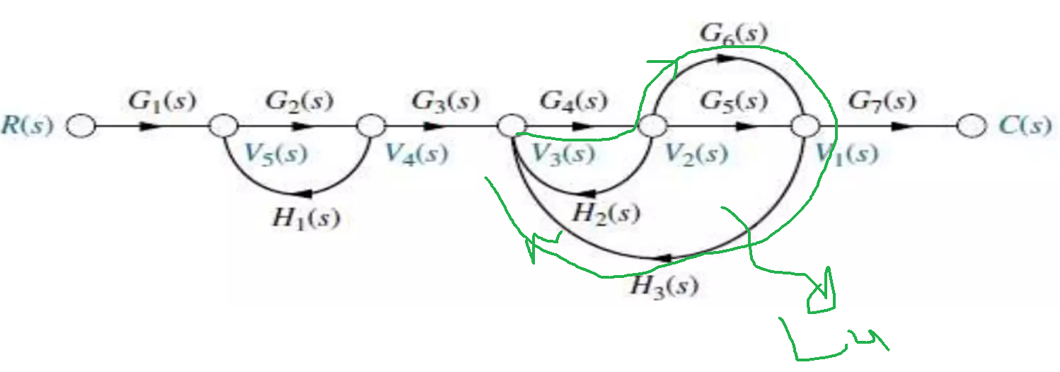
LOOPS
$$Number of Loops=L=4$$

Slide 11
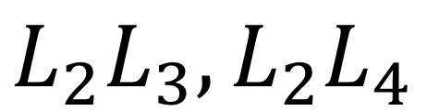
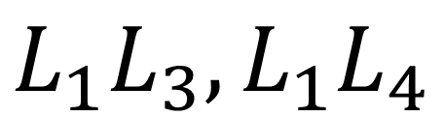
TWO NON-TOUCHING LOOPS
$$Two Non Touching Loops are as$$
$$Three Non Touching Loop=0$$
$$L_{1}L_{3},L_{1}L_{4}$$
$$L_{2}L_{3},L_{2}L_{4}$$

Slide 12
TWO NON-TOUCHING LOOPS
$$Two Non Touching Loops=L_{1}L_{2};L_{1}L_{3};L_{1}L_{4}$$

Slide 13
GAINS OF TWO NON-TOUCHING LOOPS
$$Gains of Two Non Touching Loops$$
$$1.L_{1}L_{2}={[G}_{2}\left(s\right)H_{1}(s)]{[G}_{4}\left(s\right)H_{2}(s)]$$
$$2.L_{1}L_{3}={[G}_{2}\left(s\right)H_{1}(s)]{[G}_{4}\left(s\right){G_{5}\left(s\right)H}_{3}(s)]$$
$$3.L_{1}L_{4}={[G}_{2}\left(s\right)H_{1}(s)]{[G}_{4}\left(s\right){G_{6}\left(s\right)H}_{3}(s)]$$

Slide 14
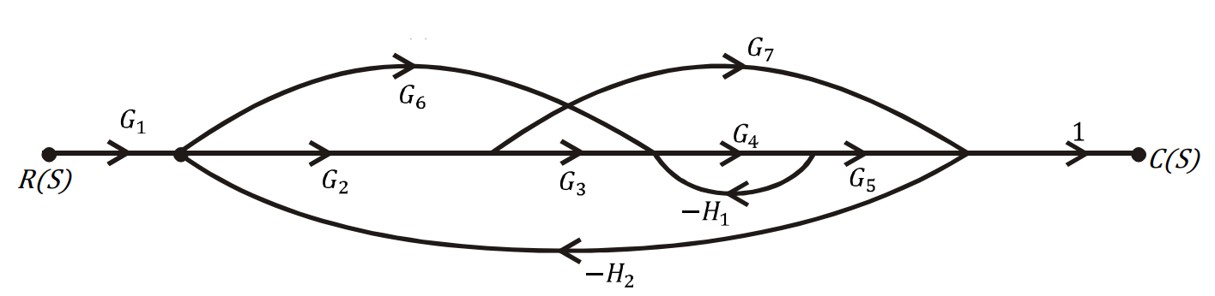
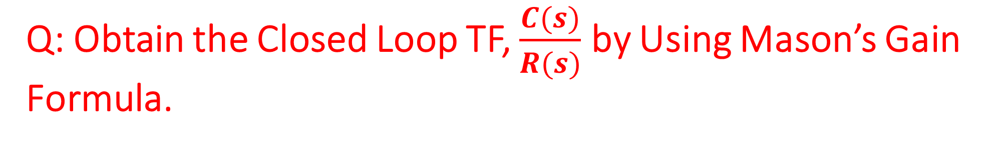
Q: Obtain the Closed Loop TF, $\frac{C(s)}{R(s)}$ by Using Mason’s Gain Formula.

Slide 15
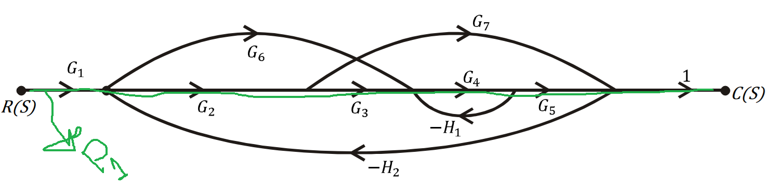
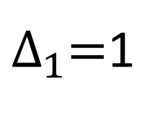
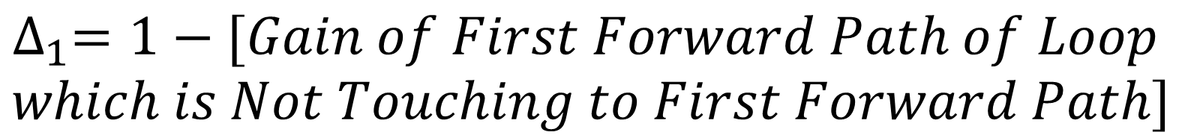
STEP-1: Find the Gain of First Forward Path of $P_{1}$ and $∆_{1}$
$$Gain of First Forward Path P_{1}=G_{1}G_{2}G_{3}G_{4}G_{5}$$
$$∆_{1}=1−[Gain of First Forward Path of Loop$$
$$which is Not Touching to First Forward Path]$$
$$∆_{1}=1−\left[0\right]=1, because all loops touch to Path 1$$
$∆_{1}=$1

Slide 16
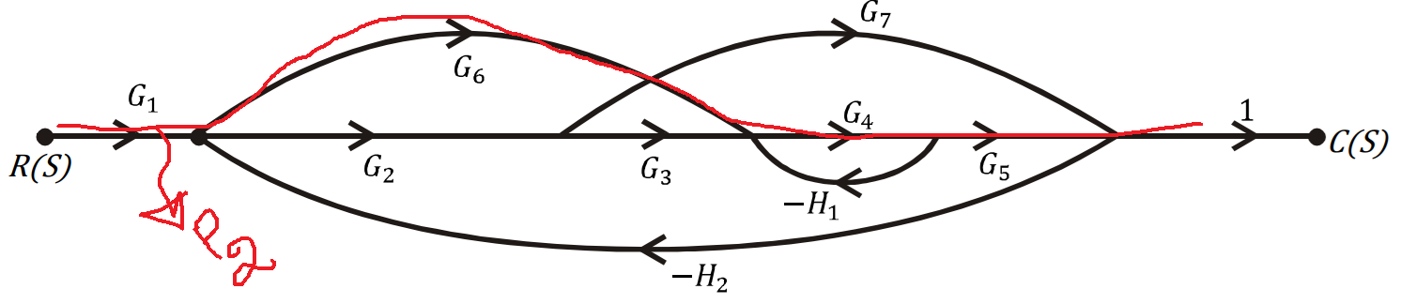
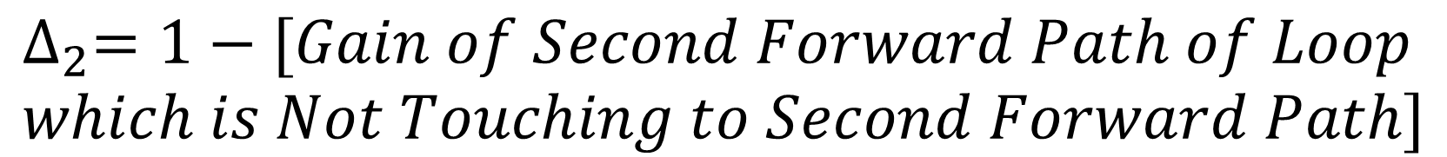
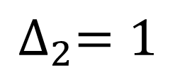
STEP-1: Find the Gain of Second Forward Path of $P_{2}$ and $∆_{2}$
$$Gain of Second Forward Path P_{2}=G_{1}G_{6}G_{4}G_{5}$$
$$∆_{2}=1−[Gain of Second Forward Path of Loop$$
$$which is Not Touching to Second Forward Path]$$
$$∆_{2}=1−\left[0\right]=1, because all loops touch to Path 2$$
$$∆_{2}=1$$

Slide 17
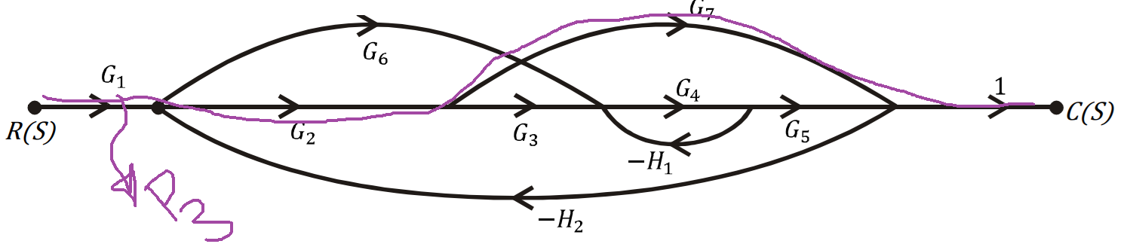
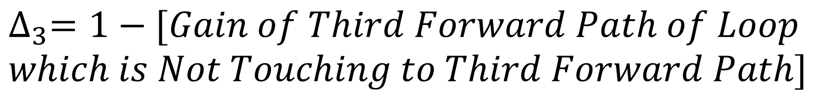
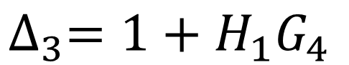
STEP-1: Find the Gain of Third Forward Path of $P_{2}$ and $∆_{3}$
$$Gain of Third Forward Path P_{3}=G_{1}G_{2}G_{7}$$
$$∆_{3}=1−[Gain of Third Forward Path of Loop$$
$$which is Not Touching to Third Forward Path]$$
$$∆_{3}=1−\left[{−H}_{1}G_{4}\right]=1+H_{1}G_{4}$$
$$∆_{3}=1+H_{1}G_{4}$$

Slide 18
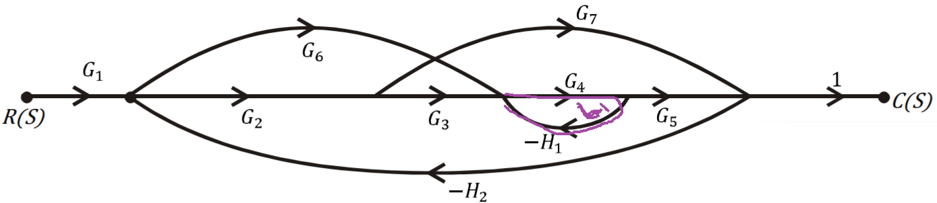
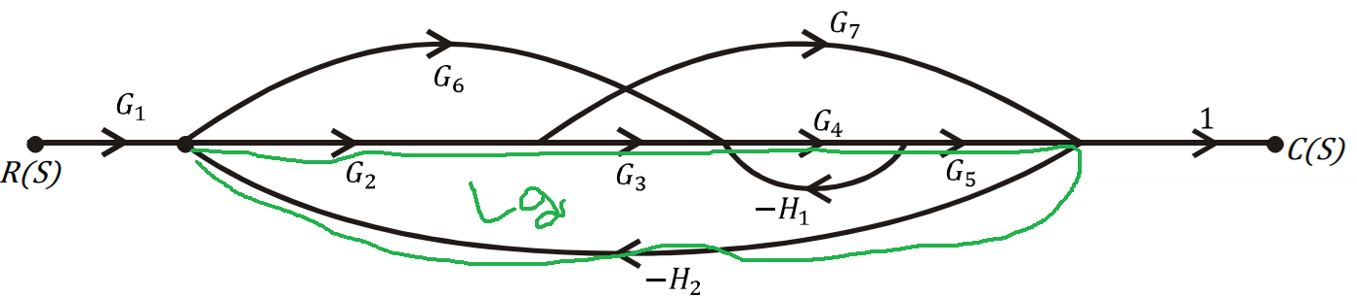
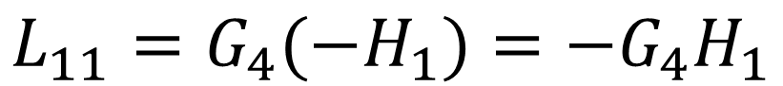
STEP-2: Find Number of Individual Loops
$$L_{11}=G_{4}{(−H}_{1})=−G_{4}H_{1}$$
$$L_{21}=G_{2}G_{3}G_{4}G_{5}{(−H}_{2})=−G_{2}G_{3}G_{4}G_{5}H_{2}$$

Slide 19
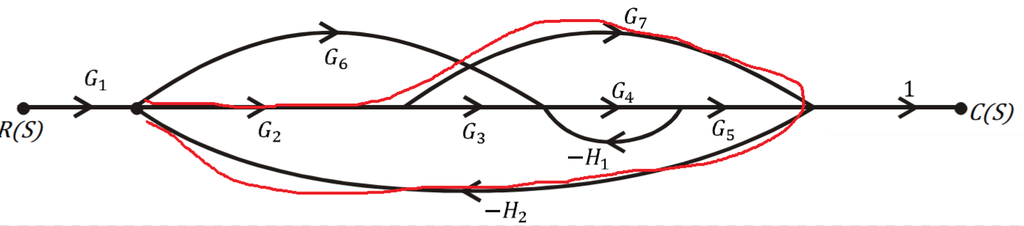
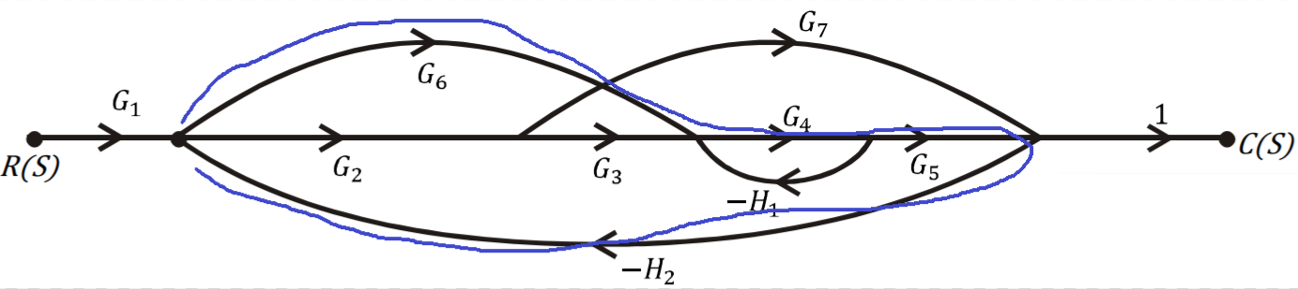
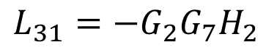
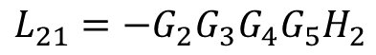
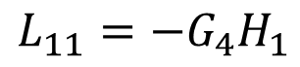
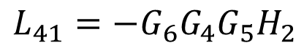
STEP-2: Find Number of Individual Loops
$$L_{11}=−G_{4}H_{1}$$
$$L_{31}=G_{2}G_{7}{(−H}_{2})=−G_{2}G_{7}H_{2}$$
$$L_{21}=−G_{2}G_{3}G_{4}G_{5}H_{2}$$
$$L_{31}=−G_{2}G_{7}H_{2}$$
$$L_{41}=−G_{6}G_{4}G_{5}H_{2}$$
$$L_{41}=G_{6}G_{4}G_{5}{(−H}_{2})=−G_{6}G_{4}G_{5}H_{2}$$

Slide 20
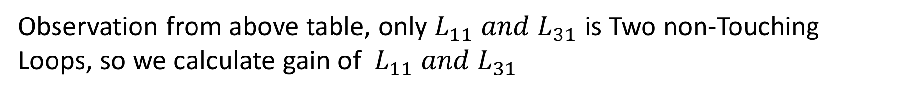
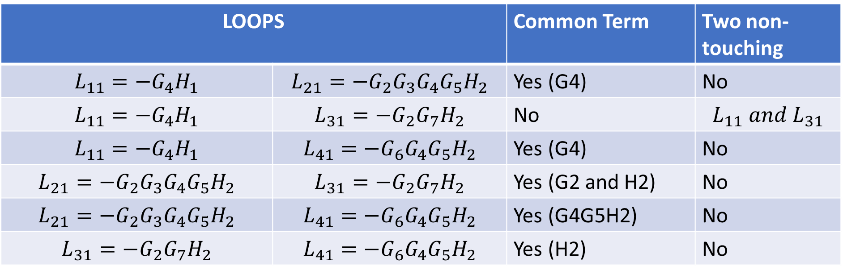
STEP-3: Find No. Of Two Non-Touching Loops
LOOPS |  | Common Term | Two non-touching
$$L_{11}=−G_{4}H_{1}$$ | $$L_{21}=−G_{2}G_{3}G_{4}G_{5}H_{2}$$ | Yes (G4) | No
$$L_{11}=−G_{4}H_{1}$$ | $$L_{31}=−G_{2}G_{7}H_{2}$$ | No | $$L_{11} and L_{31}$$
$$L_{11}=−G_{4}H_{1}$$ | $$L_{41}=−G_{6}G_{4}G_{5}H_{2}$$ | Yes (G4) | No
$$L_{21}=−G_{2}G_{3}G_{4}G_{5}H_{2}$$ | $$L_{31}=−G_{2}G_{7}H_{2}$$ | Yes (G2 and H2) | No
$$L_{21}=−G_{2}G_{3}G_{4}G_{5}H_{2}$$ | $$L_{41}=−G_{6}G_{4}G_{5}H_{2}$$ | Yes (G4G5H2) | No
$$L_{31}=−G_{2}G_{7}H_{2}$$ | $$L_{41}=−G_{6}G_{4}G_{5}H_{2}$$ | Yes (H2) | No
Observation from above table, only $L_{11} and L_{31}$ is Two non-Touching Loops, so we calculate gain of $L_{11} and L_{31}$
$$L_{12}=L_{11}∗L_{31}=\left(−G_{4}H_{1}\right)∗\left(−G_{2}G_{7}H_{2}\right)=H_{1}H_{2}G_{2}G_{4}G_{7}$$

Slide 21
STEP-4: Find the No. Of Three Non-Touching Loops
No. of three non-touching loops = 0.

Slide 22
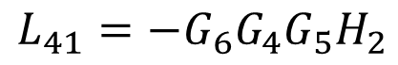
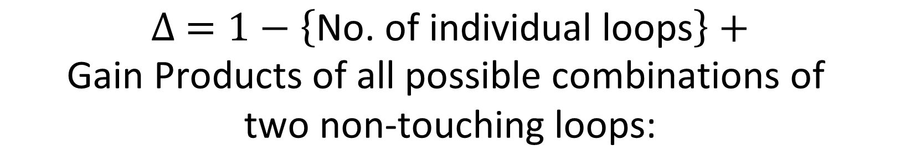
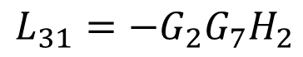

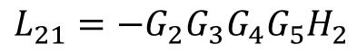
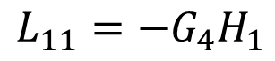
STEP-5: Find the Value of $∆$
$$∆ =1−\left\{\text{No}\text{. }\text{of} \text{individual} \text{loops}\right\}+$$
$$\text{Gain} \text{Products} \text{of} \text{all} \text{possible} \text{combinations} \text{of}$$
$$\text{two} \text{non}\text{−}\text{touching} \text{loops}\text{:}$$
$$L_{11}=−G_{4}H_{1}$$
$$L_{21}=−G_{2}G_{3}G_{4}G_{5}H_{2}$$
$$L_{31}=−G_{2}G_{7}H_{2}$$
$$∆ =1−\left\{L_{11}+L_{21}+L_{31}+L_{41}\right\}+L_{12}$$
$$L_{41}=−G_{6}G_{4}G_{5}H_{2}$$
$$∆ =1−\left\{−G_{4}H_{1}−G_{2}G_{3}G_{4}G_{5}H_{2}−G_{2}G_{7}H_{2}−G_{6}G_{4}G_{5}H_{2}\right\}+H_{1}H_{2}G_{2}G_{4}G_{7}$$
$$∆ =1+G_{4}H_{1}+G_{2}G_{3}G_{4}G_{5}H_{2}+G_{2}G_{7}H_{2}+G_{6}G_{4}G_{5}H_{2}+H_{1}H_{2}G_{2}G_{4}G_{7}$$

Slide 23
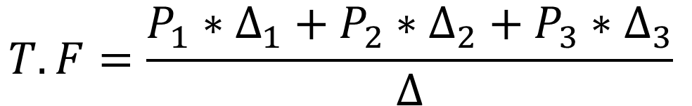
STEP-6: Find the value of Transfer Function
$$T.F=\frac{P_{1}∗∆_{1}+P_{2}∗∆_{2}+P_{3}∗∆_{3}}{∆}$$
$$T.F=\frac{G_{1}G_{2}G_{3}G_{4}G_{5}∗1+G_{1}G_{6}G_{4}G_{5}∗1+G_{1}G_{2}G_{7}∗(1+H_{1}G_{4})}{1+G_{4}H_{1}+G_{2}G_{3}G_{4}G_{5}H_{2}+G_{2}G_{7}H_{2}+G_{6}G_{4}G_{5}H_{2}+H_{1}H_{2}G_{2}G_{4}G_{7}}$$
$$T.F=\frac{G_{1}G_{2}G_{3}G_{4}G_{5}+G_{1}G_{6}G_{4}G_{5}+G_{1}G_{2}G_{7}(1+H_{1}G_{4})}{1+G_{4}H_{1}+G_{2}G_{3}G_{4}G_{5}H_{2}+G_{2}G_{7}H_{2}+G_{6}G_{4}G_{5}H_{2}+H_{1}H_{2}G_{2}G_{4}G_{7}}$$

Slide 24
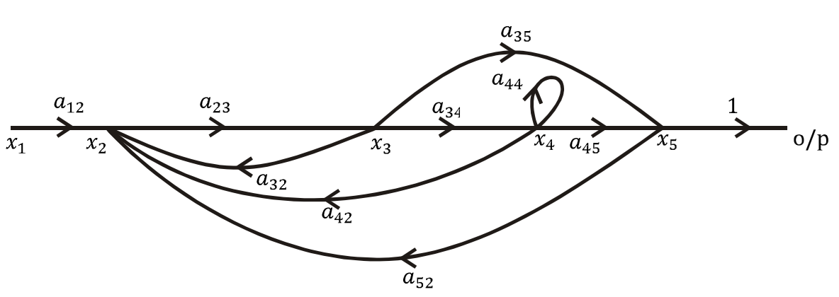
Q: Obtain the Closed Loop TF, $\frac{C(s)}{R(s)}$ by Using Mason’s Gain Formula.

Slide 25
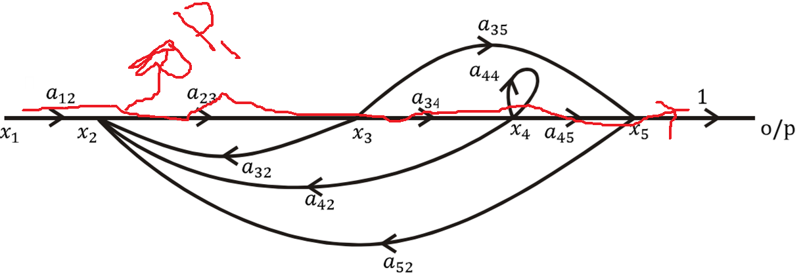
STEP-1: Find the Gain of First Forward Path of $P_{1}$ and $∆_{1}$
$$Gain of First Forward Path P_{1}=a_{12}a_{23}a_{34}a_{45}$$
$$∆_{1}=1−[Gain of First Forward Path of Loop$$
$$which is Not Touching to First Forward Path]$$
$$∆_{1}=1−\left[0\right]=1, because all loops touch to Path 1$$
$∆_{1}=$1

Slide 26
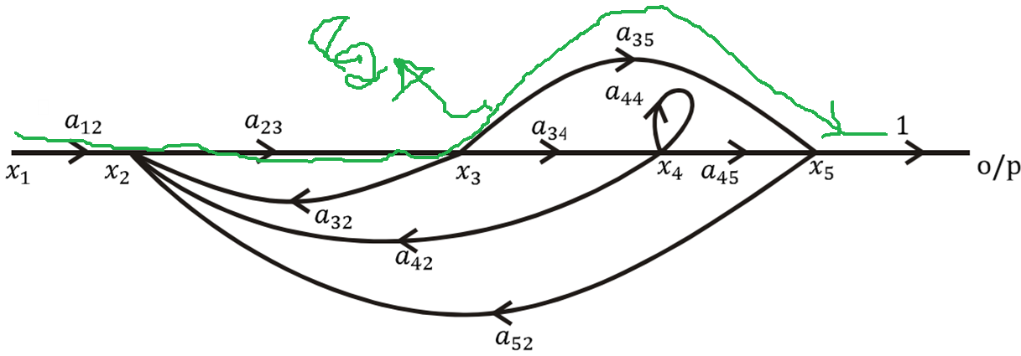
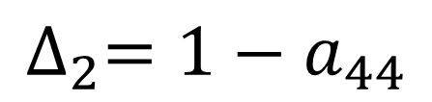
STEP-1: Find the Gain of Second Forward Path of $P_{2}$ and $∆_{2}$
$$Gain of Second Forward Path P_{2}=a_{12}a_{23}a_{35}$$
$$∆_{2}=1−[Gain of Second Forward Path of Loop$$
$$which is Not Touching to Second Forward Path]$$
$$∆_{2}=1−a_{44}, not touch to second forward path$$
$$∆_{2}=1−a_{44}$$

Slide 27
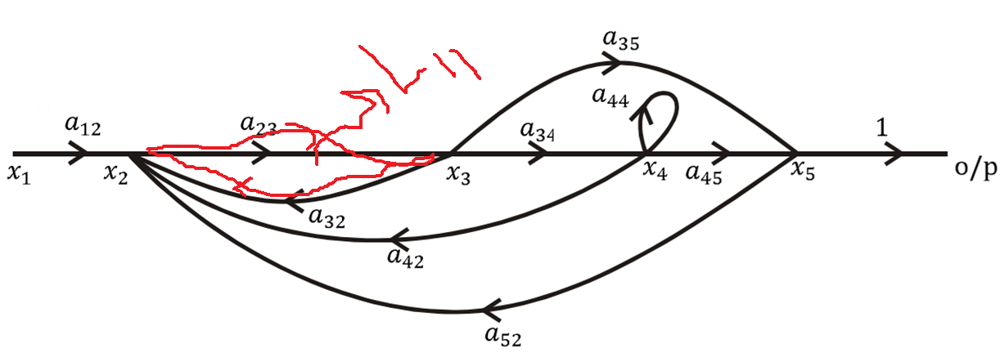
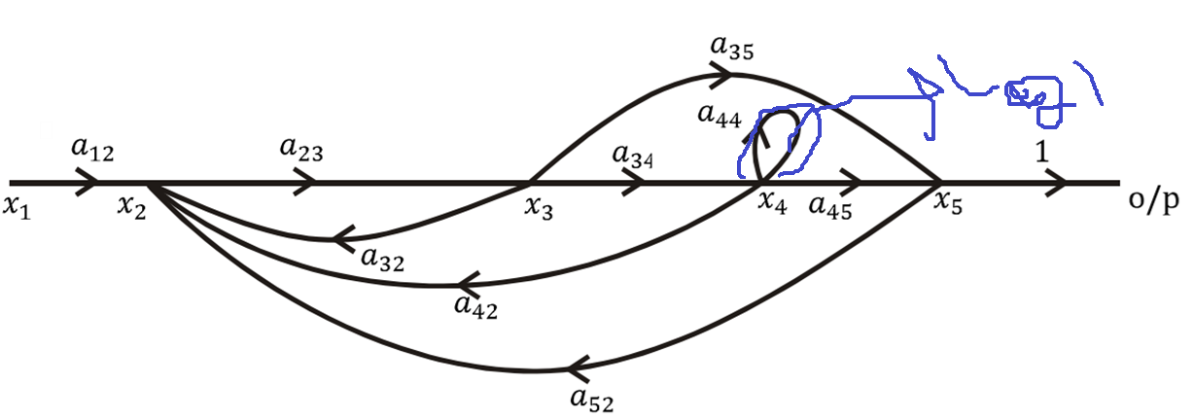


STEP-2: Find Number of Individual Loops
$$L_{11}=a_{23}a_{32}$$
$$L_{21}=a_{44}$$

Slide 28




STEP-2: Find Number of Individual Loops
$$L_{31}=a_{23}a_{34}a_{42}$$
$$L_{41}=a_{23}a_{34}a_{45}a_{52}$$

Slide 29







STEP-2: Find Number of Individual Loops
$$L_{11}=a_{23}a_{32}$$
$$L_{21}=a_{44}$$
$$L_{31}=a_{23}a_{34}a_{42}$$
$$L_{41}=a_{23}a_{34}a_{45}a_{52}$$
$$L_{51}=a_{23}a_{35}a_{52}$$
$$L_{51}=a_{23}a_{35}a_{52}$$

Slide 30


STEP-3: Find No. Of Two Non-Touching Loops
LOOPS |  | Common Term | Two non-touching
$$L_{11}=a_{23}a_{32}$$ | $$L_{21}=a_{44}$$ | No | $$L_{11} and L_{21}$$
$$L_{11}=a_{23}a_{32}$$ | $$L_{31}=a_{23}a_{34}a_{42}$$ | Yes ($a_{23}$) | $$\text{No}$$
$$L_{11}=a_{23}a_{32}$$ | $$L_{41}=a_{23}a_{34}a_{45}a_{52}$$ | Yes ($a_{23}$) | $$\text{No}$$
$$L_{11}=a_{23}a_{32}$$ | $$L_{51}=a_{23}a_{35}a_{52}$$ | Yes ($a_{23}$) | No
$$L_{21}=a_{44}$$ | $$L_{31}=a_{23}a_{34}a_{42}$$ | Yes (subscript 4) | No
$$L_{21}=a_{44}$$ | $$L_{41}=a_{23}a_{34}a_{45}a_{52}$$ | Yes (subscript 4) | No
$$L_{21}=a_{44}$$ | $$L_{51}=a_{23}a_{35}a_{52}$$ | No | $$L_{21} and L_{51}$$
$$L_{31}=a_{23}a_{34}a_{42}$$ | $$L_{41}=a_{23}a_{34}a_{45}a_{52}$$ | Yes | No
$$L_{31}=a_{23}a_{34}a_{42}$$ | $$L_{51}=a_{23}a_{35}a_{52}$$ | Yes | No
$$L_{41}=a_{23}a_{34}a_{45}a_{52}$$ | $$L_{51}=a_{23}a_{35}a_{52}$$ | Yes | No
Observation from above table, only $L_{11} L_{21} and L_{21} L_{51}$is Two non-Touching Loops, so we calculate gain
$$L_{12}=L_{11}L_{21}=a_{23}a_{32}∗a_{44}$$
$$L_{22}=L_{21}L_{51}=a_{44}∗a_{23}a_{35}a_{52}$$

Slide 31
STEP-4: Find the No. Of Three Non-Touching Loops
No. of three non-touching loops = 0.

Slide 32







STEP-5: Find the Value of $∆$
$$L_{11}=a_{23}a_{32}$$
$$∆ =1−\left\{\text{No}\text{. }\text{of} \text{individual} \text{loops}\right\}+$$
$$\text{Gain} \text{Products} \text{of} \text{all} \text{possible} \text{combinations} \text{of}$$
$$\text{two} \text{non}\text{−}\text{touching} \text{loops}\text{:}$$
$$L_{21}=a_{44}$$
$$L_{31}=a_{23}a_{34}a_{42}$$
$$L_{41}=a_{23}a_{34}a_{45}a_{52}$$
$$∆ =1−\left\{L_{11}+L_{21}+L_{31}+L_{41}+L_{51}\right\}{+L_{12}+L}_{22}$$
$$L_{51}=a_{23}a_{35}a_{52}$$
$${∆ =1−\left\{a_{23}a_{32}+a_{44}+a_{23}a_{34}a_{42}+a_{23}a_{34}a_{45}a_{52}+a_{23}a_{35}a_{52}\right\}+a}_{23}a_{32}∗a_{44}+a_{44}∗a_{23}a_{35}a_{52}$$
$${∆ =1−a_{23}a_{32}−a_{44}−a_{23}a_{34}a_{42}−a_{23}a_{34}a_{45}a_{52}−a_{23}a_{35}a_{52}+a}_{23}a_{32}a_{44}+a_{44}a_{23}a_{35}a_{52}$$

Slide 33

STEP-6: Find the value of Transfer Function
$$T.F=\frac{P_{1}∗∆_{1}+P_{2}∗∆_{2}}{∆}$$
$$T.F=\frac{a_{12}a_{23}a_{34}a_{45}∗1+a_{12}a_{23}a_{35}∗(1−a_{44})}{{1−a_{23}a_{32}−a_{44}−a_{23}a_{34}a_{42}−a_{23}a_{34}a_{45}a_{52}−a_{23}a_{35}a_{52}+a}_{23}a_{32}a_{44}+a_{44}a_{23}a_{35}a_{52}}$$
$$TF=\frac{a_{12}a_{23}a_{34}a_{45}+a_{12}a_{23}a_{35}(1−a_{44})}{{1−a_{23}a_{32}−a_{44}−a_{23}a_{34}a_{42}−a_{23}a_{34}a_{45}a_{52}−a_{23}a_{35}a_{52}+a}_{23}a_{32}a_{44}+a_{44}a_{23}a_{35}a_{52}}$$

Slide 34

Q: Obtain the Closed Loop TF, $\frac{C(s)}{R(s)}$ by Using Mason’s Gain Formula.

Slide 35


STEP-1: Find the Gain of First Forward Path of $P_{1}$ and $∆_{1}$
$$Gain of First Forward Path P_{1}=G_{1}G_{2}$$
$$∆_{1}=1−[Gain of First Forward Path of Loop$$
$$which is Not Touching to First Forward Path]$$
$$∆_{1}=1−\left[0\right]=1, because all loops touch to Path 1$$
$∆_{1}=$1

Slide 36



STEP-1: Find the Gain of Second Forward Path of $P_{2}$ and $∆_{2}$
$$Gain of Second Forward Path P_{2}=G_{4}$$
$$∆_{2}=1−[Gain of Second Forward Path of Loop$$
$$which is Not Touching to Second Forward Path]$$
$$∆_{2}=1−G_{2}G_{3}, not touch to second forward path$$
$$∆_{2}=1−G_{2}G_{3}$$

Slide 37



STEP-2: Find Number of Individual Loops
$$L_{11}=G_{2}G_{3}$$
$$L_{21}=G_{1}G_{2}\left(−G_{5}\right)=−G_{1}{G_{2}G}_{5}$$

Slide 38





STEP-2: Find Number of Individual Loops
$$L_{11}=G_{2}G_{3}$$
$$L_{31}=G_{4}\left(−G_{5}\right)=−G_{4}G_{5}$$
$$L_{21}=−G_{1}{G_{2}G}_{5}$$
$$L_{31}=−G_{4}G_{5}$$

Slide 39

STEP-3: Find No. Of Two Non-Touching Loops
LOOPS |  | Common Term | Two non-touching
$$L_{11}=G_{2}G_{3}$$ | $$L_{21}=−G_{1}{G_{2}G}_{5}$$ | Yes ($G_{2}$) | $$\text{No}$$
$$L_{11}=G_{2}G_{3}$$ | $$L_{31}=−G_{4}G_{5}$$ | No | $$L_{11} and L_{31}$$
$$L_{21}=−G_{1}{G_{2}G}_{5}$$ | $$L_{31}=−G_{4}G_{5}$$ | Yes ($G_{5}$) | No
Observation from above table, only $L_{11} L_{31}$is Two non-Touching Loops, so we calculate gain
$$L_{12}=L_{11}L_{31}=\left(G_{2}G_{3}\right)∗\left(−G_{4}G_{5}\right)=−G_{2}G_{3}G_{4}G_{5}$$

Slide 40
STEP-4: Find the No. Of Three Non-Touching Loops
No. of three non-touching loops = 0.

Slide 41



STEP-5: Find the Value of $∆$
$$∆ =1−\left\{\text{No}\text{. }\text{of} \text{individual} \text{loops}\right\}+$$
$$\text{Gain} \text{Products} \text{of} \text{all} \text{possible} \text{combinations} \text{of}$$
$$\text{two} \text{non}\text{−}\text{touching} \text{loops}\text{:}$$
$$L_{11}=G_{2}G_{3}$$
$$L_{21}=−G_{1}{G_{2}G}_{5}$$
$$L_{31}=−G_{4}G_{5}$$
$$∆ =1−\left\{L_{11}+L_{21}+L_{31}\right\}+L_{11}L_{31}$$
$$∆ =1−\left\{G_{2}G_{3}−G_{1}{G_{2}G}_{5}−G_{4}G_{5}\right\}−G_{2}G_{3}G_{4}G_{5}$$
$$∆ =1−G_{2}G_{3}+G_{1}{G_{2}G}_{5}+G_{4}G_{5}−G_{2}G_{3}G_{4}G_{5}$$

Slide 42



STEP-6: Find the value of Transfer Function
$$T.F=\frac{P_{1}∗∆_{1}+P_{2}∗∆_{2}}{∆}$$
$$T.F=\frac{G_{1}G_{2}+G_{4}(1−G_{2}G_{3})}{1−G_{2}G_{3}+G_{1}{G_{2}G}_{5}+G_{4}G_{5}−G_{2}G_{3}G_{4}G_{5} }$$
$$T.F=\frac{G_{1}G_{2}+G_{4}−G_{2}G_{3}G_{4}}{1−G_{2}G_{3}+G_{1}{G_{2}G}_{5}+G_{4}G_{5}−G_{2}G_{3}G_{4}G_{5} }$$

Slide 43


Slide 44


